Slide 1

Welcome to CHOP R 101: Intro to R for Clinical Data
Stephan Kadauke
Notes:
Start 9:02 AM
Hello and welcome!

Slide 2
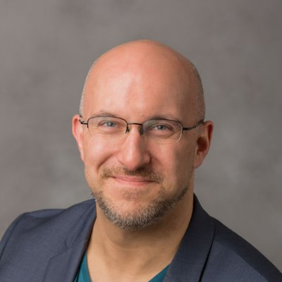
Stephan
Notes:
I'm Stephan Kadauke. I’m an Assistant Professor of Pathology and Laboratory Medicine here at CHOP. I co-direct the Cell and Gene Therapy Lab, and I see patients on the apheresis service. I’m also one of the co-founders of the CHOP R User Group and was the Chair of the Organizing Committee of the R/Medicine 2020 Virtual Conference.

Slide 3


Notes:
I’ve been coding in R for 10+ years, and I’m an RStudio Certified trainer.
I have taught R to physicians and other clinicians and clinical researchers at the Harvard Massachusetts General Hospital, at the University of Pennsylvania, and at various conferences, both online and offline.

Slide 4
Introducing the helpers!
Richard Hanna
Silvia Canelón
Cass Wilkinson-Saldaña
Rachel Kolster
Jason Xu
Joy Payton
Meredith Lee
Notes:
And we’re fortunate to have a number of helpers for the course.

Slide 5
Orientation to the Technology

Slide 6

Main session vs Breakout rooms
Webinar-style
100+ participants
Mic off
Camera off
Meeting-style
10-15 participants / room
Mic on
Camera optional
Notes:
The main part of the workshop will be webinar style, with everyone in one big session, and participants will be muted and cameras off. We are recording the main session for replay.
** We will also take advantage of breakout rooms, which are a feature of Zoom that allows more of a meeting-style kind of conferencing. We will use breakout rooms for two purposes: for one, we’ll have a small number of group exercises for which we’ll break you guys up into groups of 10-15, and you’ll have the opportunity to talk to each other. We also encourage you to turn on your camera, if your are comfortable, but that's completely up to you. We won't record breakout sessions. The other purpose of breakout rooms will be to get you 1:1 help by one of the helpers if you are stuck or have some kind of technical problem.

Slide 7
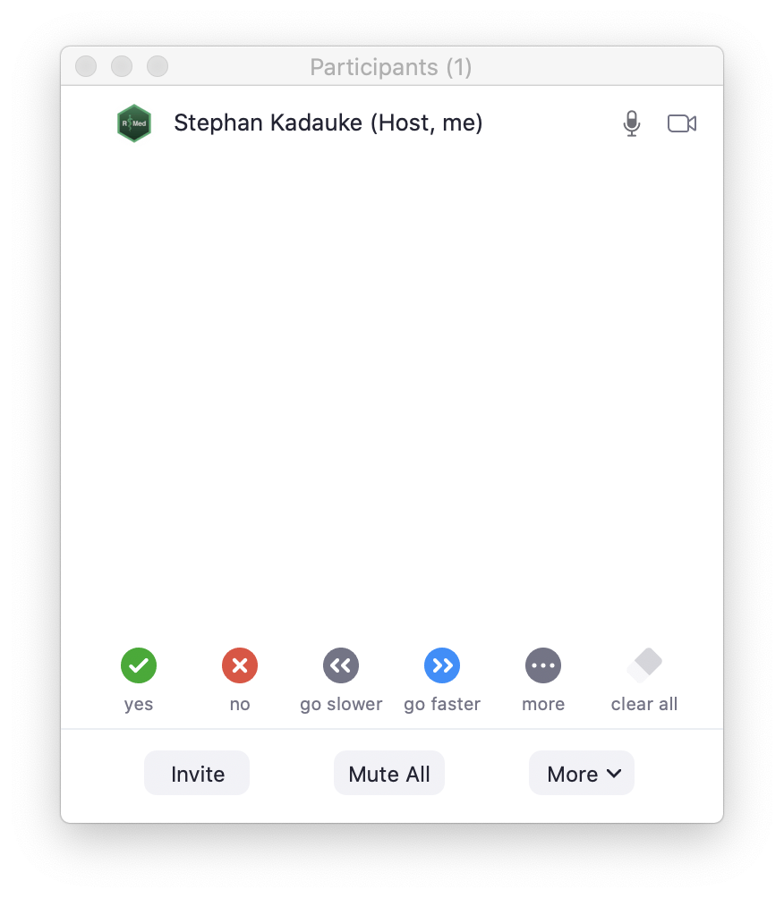

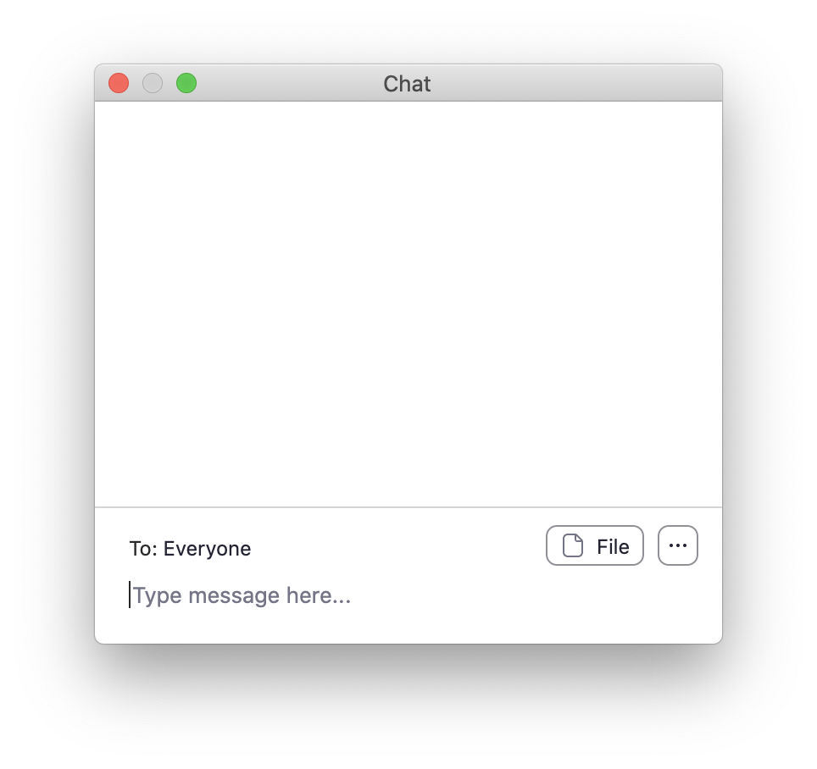
Notes:
This is the main Zoom window. On the bottom you should be able to see two buttons - Participants and Chat.
Click on these buttons now to open the ** Participants and ** Chat windows, and place those windows somewhere you can see, if necessary by making your main Zoom window a little smaller.

Slide 8
Non-verbal feedback
Notes:
We will make heavy use of the Non-verbal Feedback functionality of Zoom. At various points, I will ask you to click "Yes" to let me know I can keep going. What I mean by that is to click the ** green circle with the check mark in the Participants window.

Slide 9
Chat window
Notes:
The primary purpose of the Chat window, for this course, is to ask for help if you get stuck with a technical issue. If you don’t have a problem that someone is helping you with, you do not need to monitor the chat window to follow the course. I will also occasionally ask you to write the answer to a question in the chat.
Please note that when I’m presenting, I can’t also monitor the chat at the same time, so please don't send me private messages. Instead, post to Everyone, briefly describing the problem you have, and you will get help by one of our TAs.
I also want to set expectations for help here. If you have a technical problem please use the chat to get help. But if you have questions about the material, or how to solve a problem you have that’s related to what we’re talking about at the moment, I encourage you to write it down, and ask during the breaks, or after the workshop.

Slide 10
Your Turn #1
Click the “yes” button in the Participants window.
Then write your job description and department in the Chat window.
Notes:
This brings us to the first interactive exercise!
...

Slide 11
Orientation to the Course

Slide 12
The Data Analysis Pipeline
Notes:
This in a gentle introduction to data science designed for healthcare professionals and clinical researchers who don't have a background in programming. This slide shows a high-level conceptual framework of the most important steps of the data analysis process. You always start by importing data and cleaning or "tidying" it up. Then you start an iterative process of exploratory data analysis, which usually requires some data transformation. The main engines of knowledge generation are visualization and modeling. Finally, you need to communicate your results.
We will introduce the basics of all of these steps today, with the exception of modeling.

Slide 13
Welcome | 9:00 – 9:20
Introduction | 9:20 – 10:30
Visualize | 10:35 – 11:20
Transform | 11:25 – 12:00
Lunch | 12:00 – 12:30
Dashboard | 12:30 – 1:30
Notes:
Here’s our plan for today.
We’ll spend the first hour and half with an Introduction to R, RStudio, and R Markdown where we will also look at how to import data into R. Then we will introduce data visualization and data transformation. After that we’ll break for lunch, and finish out by looking at how to build a basic dashboard with R.

Slide 14
Lecture slides
Notes:
In general, we will introduce new concepts with lecture slides like this one, which you can also find in your course pack.

Slide 15
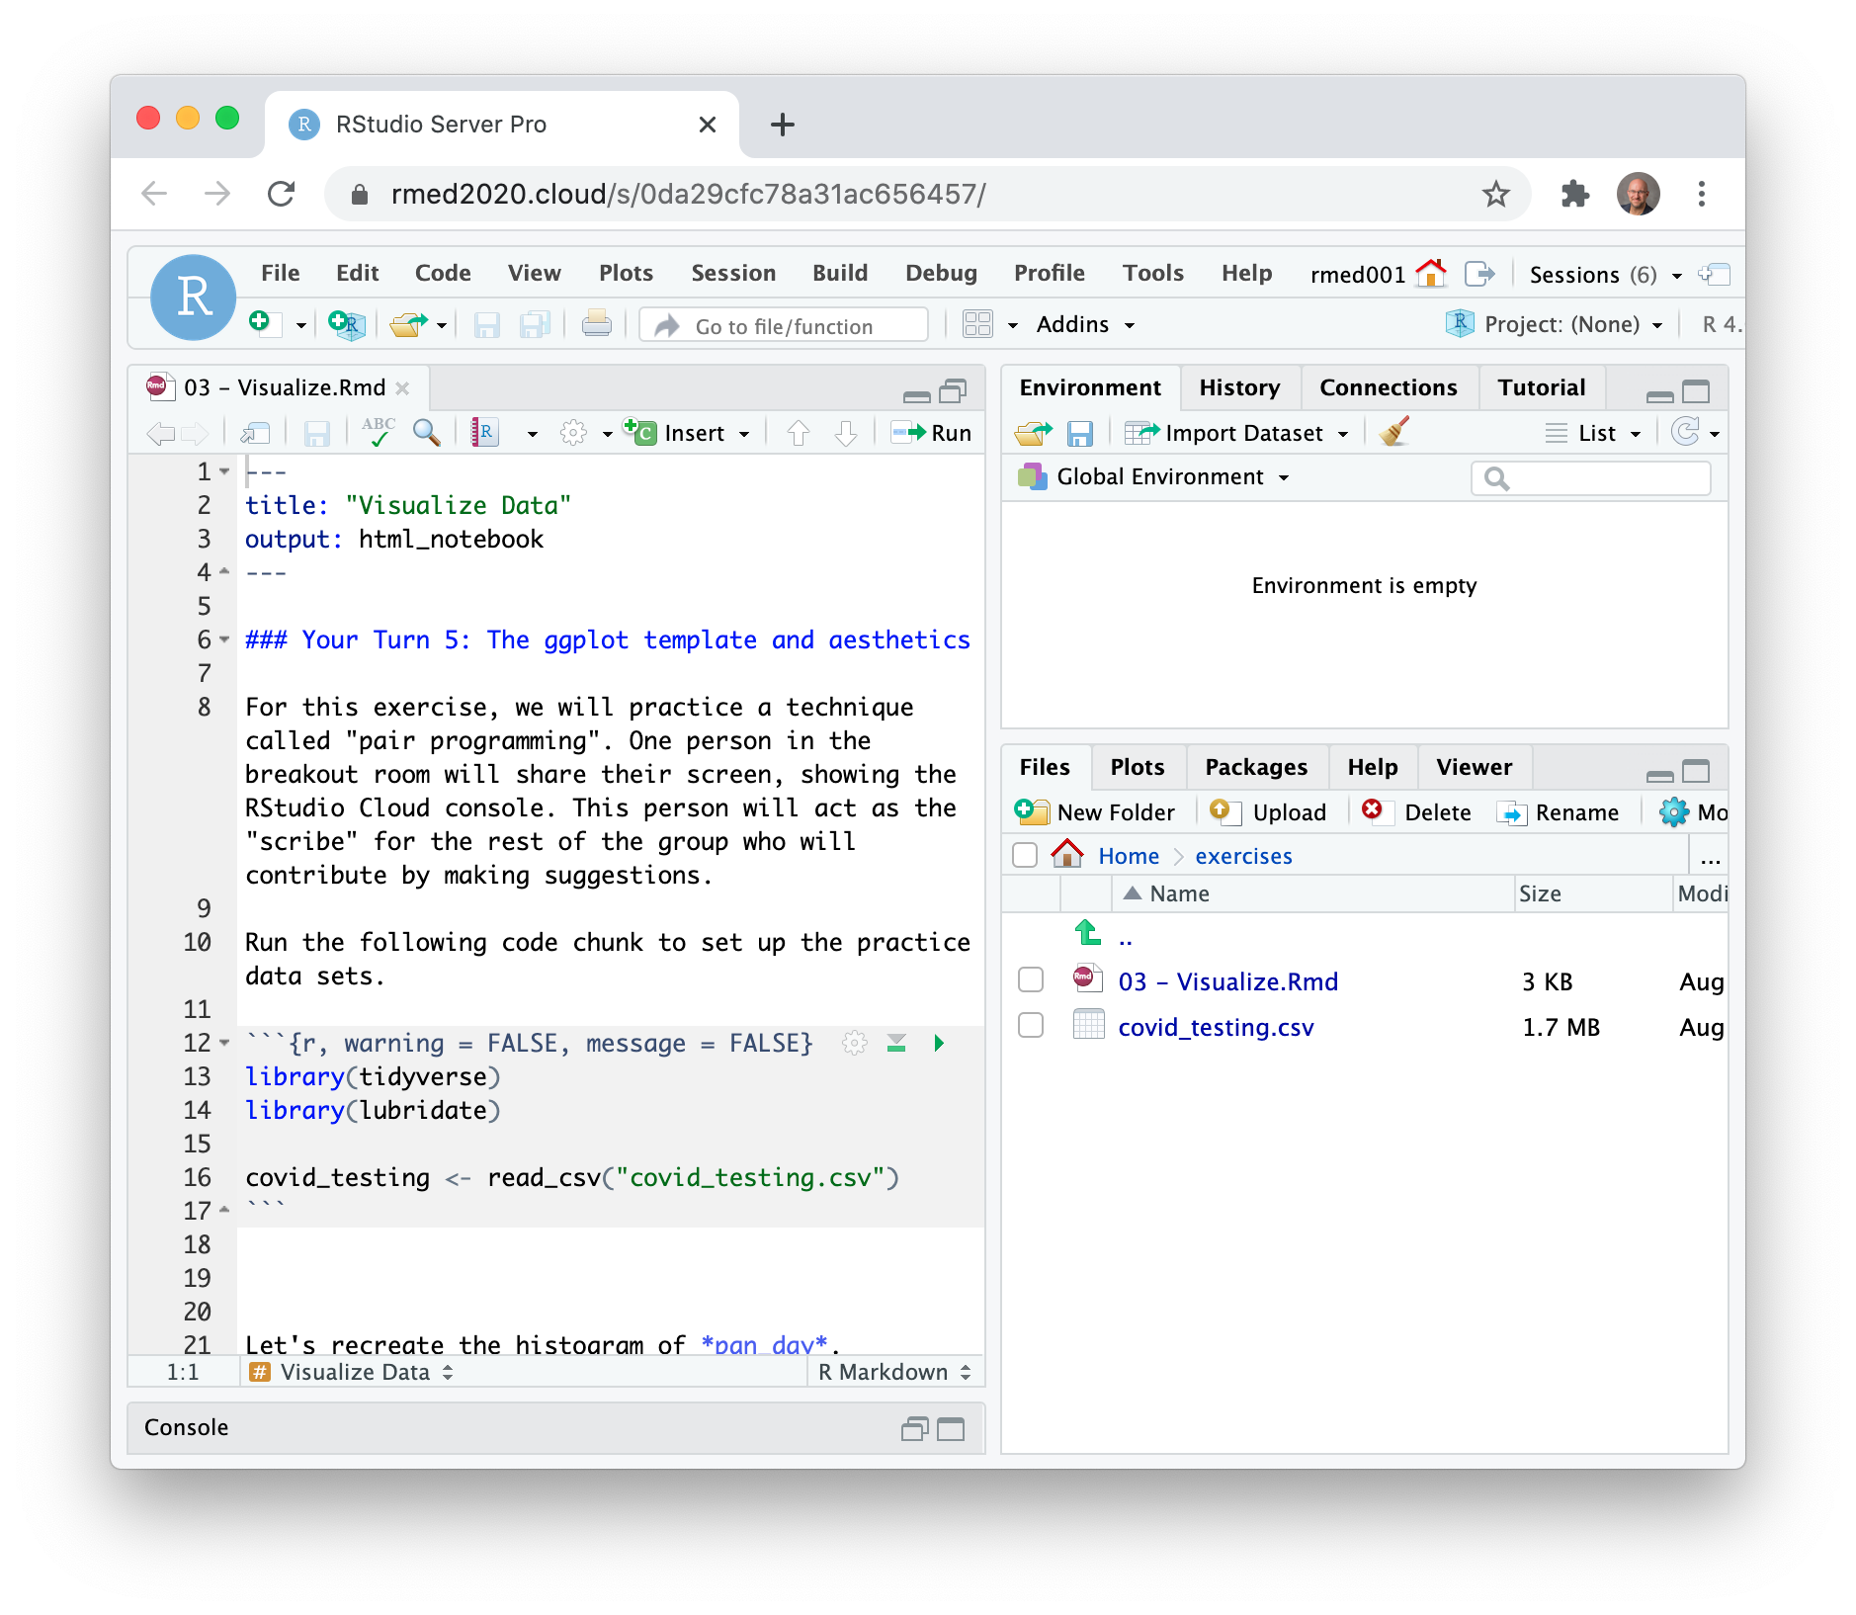
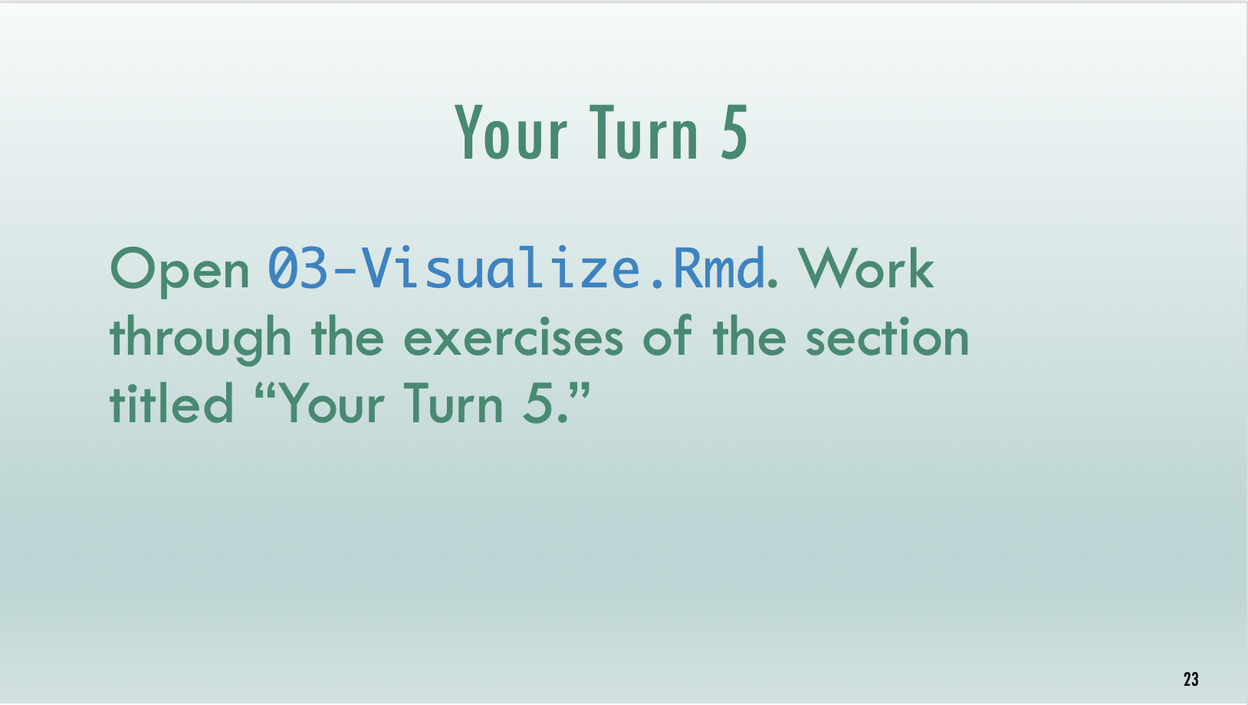
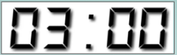
Timed interactive coding exercises
Notes:
And then practice these new skills with timed interactive coding exercises. For the coding exercises, we set up a training environment on the web specifically for this course.
Please note that these exercises are timed. It's not essential that you finish each exercise, but it's essential that you try. When the time is up, I ask that everyone stop working. After each coding exercise, we will come back together, and I will live code the exercise to catch everyone up.

Slide 16
Code of Conduct
Screenshots
Recordings
Photographs
Harassment
https://skadauke.github.io/intro-to-r-for-clinicians-chop/conduct.html
Notes:
One more serious thing I need to point out, since this is an interactive course - we want to provide a welcoming and supportive environment for all people, regardless of background or identity.
** So we have a strict no-harassment policy: this includes abusive, offensive, or degrading language, in writing or in voice
** for full CoC please take a look at the course website > Code of Conduct or follow the link here
** Also, to respect the privacy of participants, we don’t allow screenshots, recordings, or photographs.
If we find that you violate the code of conduct we may have to remove you from the course.

Slide 17
Your Turn #2
Meet and greet! We will send you into breakout rooms, where you will have 10 minutes to meet your TA and 10-15 of your fellow participants.
Notes:
This brings us to our first breakout session!
…
For this exercise, we encourage you to turn on your microphone and camera, if you’re comfortable.
At the 10 min mark, we’ll bring everyone back into the main session.

